Slide 1
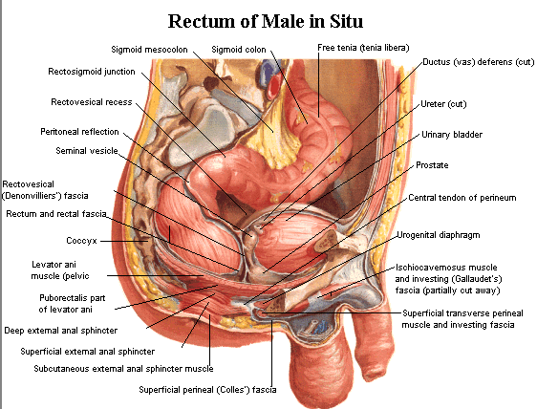
The sigmoid colon (pelvic colon)

Slide 2
40 cm in length
Begins at the superior aperture of the lesser pelvis, to the level of the third piece of the sacrum
It is completely surrounded by peritoneum forms a sigmoid mesocolon

Slide 3
The sigmoid mesocolon" V shaped"
the apex: near the division of the left common iliac artery.
The left limb descends medially to the left psoas muscle;
the right limb descends into the pelvis and ends in the midline anterior to the third sacral segment.
The sigmoid and superior rectal vessels run between the layers of the sigmoid mesocolon and the left ureter descends into the pelvis behind its apex.
mesocolon

Slide 4
Rectum (5 inches)

Slide 5
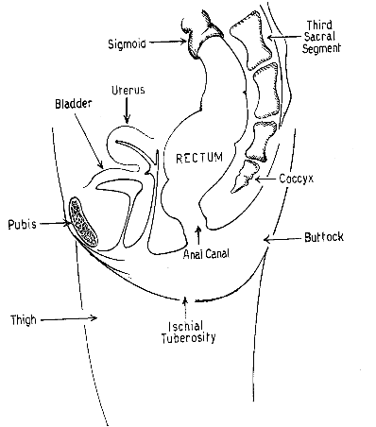
The rectum is continuous:
above, with the sigmoid colon at about the level of vertebra SIII; At this point, the teniae of the sigmoid colon spread to form a continuous outer longitudinal layer of smooth muscle, and the fatty omental appendices are discontinued.

Slide 6
The rectum is continuous:
below, with the anal canal (2.5 cm. in front of, and a little below, the tip of the coccyx) as this structure penetrates the pelvic floor and passes through the perineum to end as the anus..

Slide 7
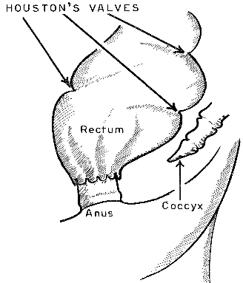
Its mucous membrane is thrown into a number of longitudinal folds, besides these there are certain permanent transverse folds, known as Houston’s valves.
They are usually three in number; one on the right side; 2 inward from the left side.

Slide 8
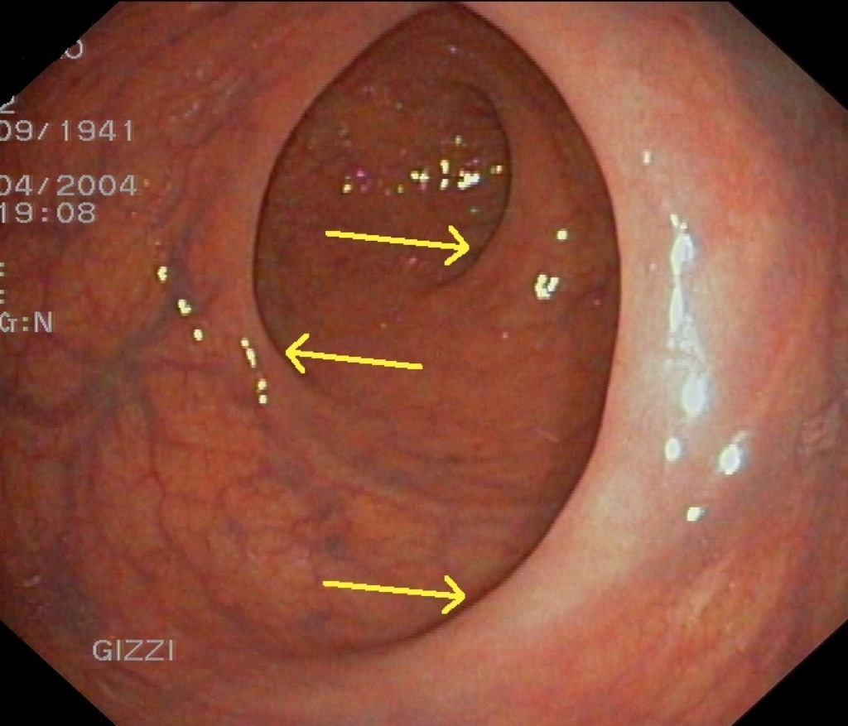

Slide 9
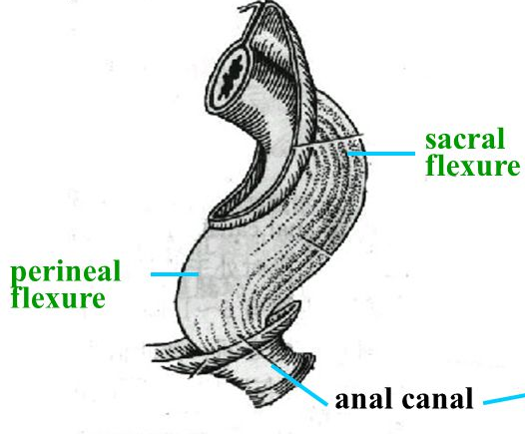
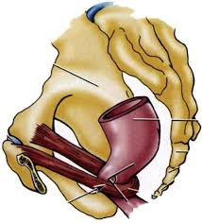
The rectum follows the curve of the sacrum: sacral flexure of the rectum. the anorectal flexure of the anal canal is pulled forward by the action of the puborectalis part of the levator ani muscle (perineal flexure)

Slide 10
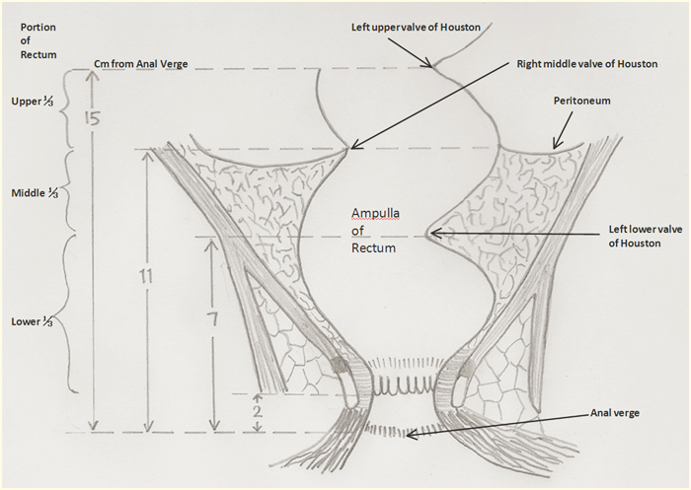
Three sharp lateral flexures of the rectum (superior and inferior on the left side, and intermediate on the right) are apparent when the rectum is viewed anteriorly which are corresponding to the transverse rectal folds.

Slide 11
The dilated terminal part of the rectum, lying superior to the pelvic diaphragm and anococcygeal ligament, is the ampulla of the rectum

Slide 12
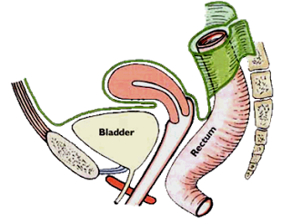
Peritoneal covering of the rectum
-upper1/3(front-sides)
-middle1/3(front)
-lower1/3(no peritoneal covering)

Slide 13
Peritoneal covering of the rectum
In females, the peritoneum reflects from the rectum to upper part of the posterior surface of the vagina, where it forms the floor of the rectouterine pouch (Douglas pouch).

Slide 14
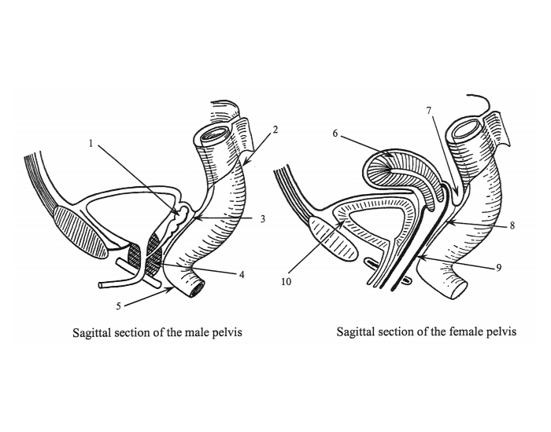
Peritoneal covering of the rectum
In males, the peritoneum reflects from the rectum to upper part of the posterior wall of the bladder, where it forms the floor of the rectovesical pouch.

Slide 15
Peritoneal covering of the rectum
In both sexes, lateral reflections of peritoneum from the superior third of the rectum form pararectal fossae, which permit the rectum to distend as it fills with feces.

Slide 16
Posterior relations: 2 bones: Inferior three sacral vertebrae and the coccyx,2Muscles:piriformis+levator ani - 2 nerves: Inferior ends of the sympathetic trunks and sacral plexuses+ sympathatic trunk

Slide 17
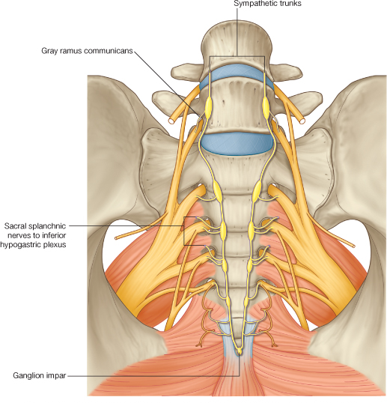
Posterior relations: 2 bones: Inferior three sacral vertebrae and the coccyx, 2Muscles:piriformis+levator ani - 2 nerves: Inferior ends of the sympathetic trunks and sacral plexuses

Slide 18
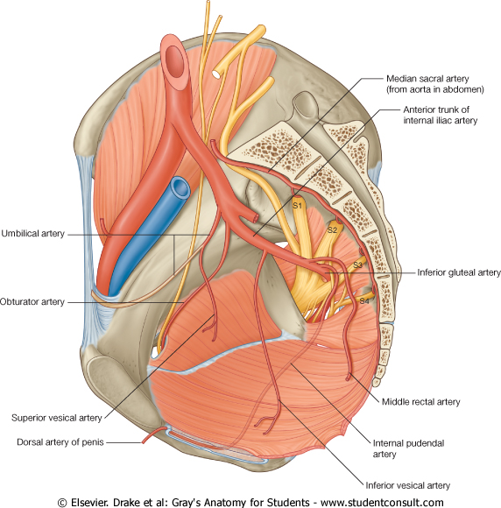
Posterior relations: 2 bones: Inferior three sacral vertebrae and the coccyx, 2Muscles:piriformis+levator ani - 2 nerves: Inferior ends of the sympathetic trunks and sacral plexuses+ 2 vessels: Median sacral vessels+ superior rectal artery +Anococcygeal ligament.

Slide 19
Posterior relations: 2 bones: Inferior three sacral vertebrae and the coccyx, 2Muscles:piriformis+levator ani - 2 nerves: Inferior ends of the sympathetic trunks and sacral plexuses+ 2 vessels: Median sacral vessels+ superior rectal artery +Anococcygeal ligament.

Slide 20
Anterior relations:
In males, the rectum is related anteriorly to the fundus of the urinary bladder, terminal parts of the ureters, ductus deferents, seminal glands, and prostate.

Slide 21
Anterior relations:
In females, the rectum is related anteriorly to the vagina and is separated from the posterior part of the fornix and the cervix by the rectouterine pouch.

Slide 22
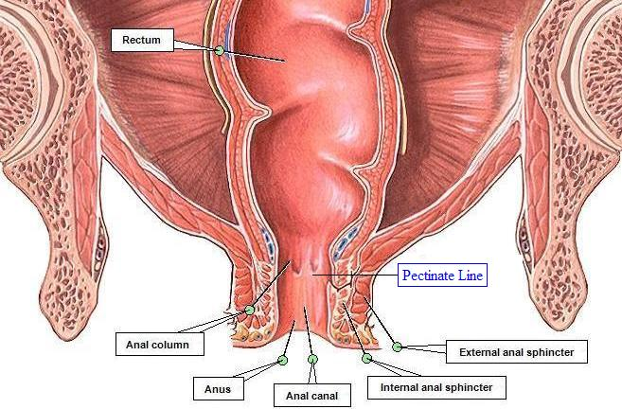
Laterally, the rectum is related to the ileum or sigmoid colon in pararectal fossa

Slide 23
per rectal(PR) examination

Slide 24
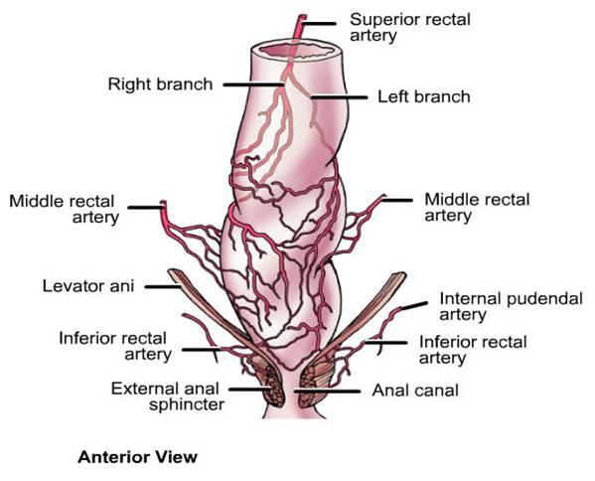
Arterial supply
The superior rectal artery, continuation of inferior mesenteric.
The right and left middle rectal arteries, from anterior divisions of the internal iliac.
The right and left inferior rectal arteries, from the internal pudendal arteries in the perineum, supply the anorectal junction and anal canal.

Slide 25
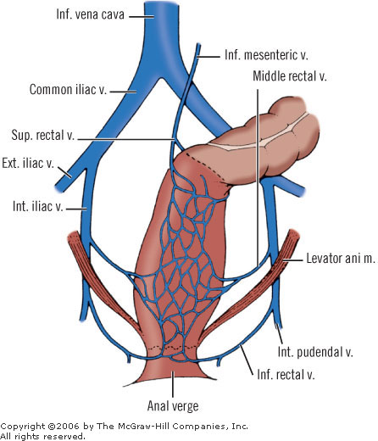
Venous drainage of rectum
The rectal venous plexus consists of two parts:
the internal submucosal rectal venous plexus and the external rectal venous plexus external to the muscular wall of the rectum.

Slide 26
Venous drainage of rectum
Superior rectal vein drains into the inferior mesenteric vein (portal venous system)
middle rectal veins drains into the internal iliac vein (systemic venous system)
inferior rectal veins into the internal pudendal vein(systemic venous system)

Slide 27
Venous drainage of rectum
Anastomoses occur between the portal and systemic veins in the wall of the anal canal (portocaval anastomosis).

Slide 28
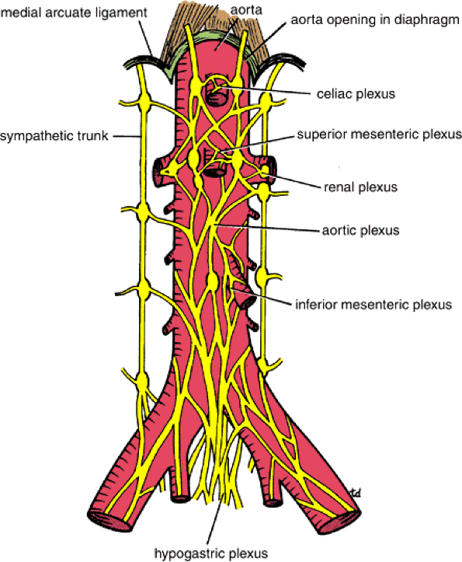
Innervations of rectum
The sympathetic supply is from L1, 2 conveyed via lumbar splanchnic nerves to the aortic plexus then to the peri-arterial plexus of the inferior mesenteric and superior rectal arteries.

Slide 29
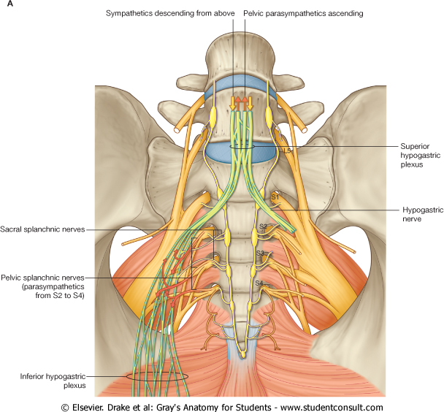
Innervations of rectum
The parasympathetic supply is from the S2-S4 spinal cord level, passing via the pelvic splanchnic nerves and the left and right inferior hypogastric plexuses to the rectal (pelvic) plexus.

Slide 30
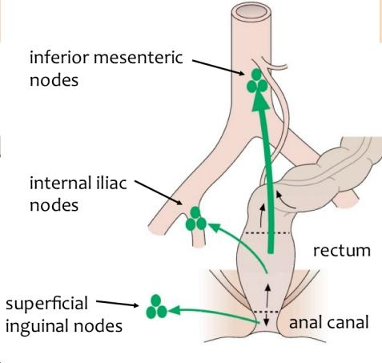
Lymphatic drainage from rectum
From the superior half rectum pass to inferior mesenteric lymph nodes, many passing through pararectal lymph nodes and/or sacral lymph nodes. The inferior mesenteric nodes drain into the lumbar (caval/aortic) lymph nodes.
From the inferior half of the rectum follows the middle rectal vessels to drain into the internal iliac lymph nodes.

Slide 31
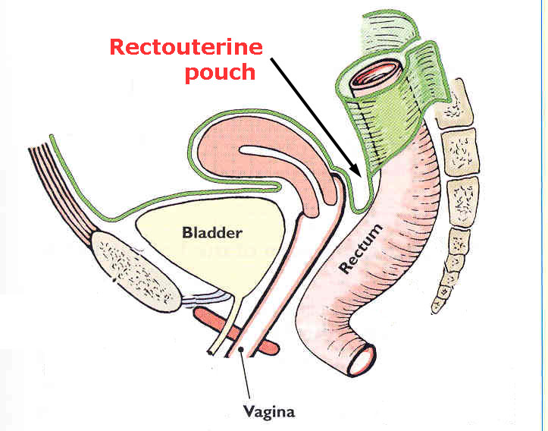
Female Internal Genital Organs
UTERUS
The uterus is a thick-walled muscular organ in the midline between the bladder and rectum.

Slide 32
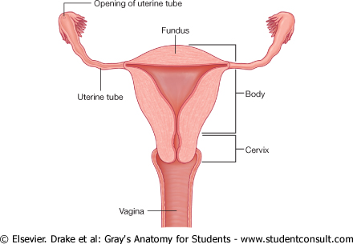
Superiorly, uterine tubes project laterally from the uterus and open into the peritoneal cavity immediately adjacent to the ovaries.
The non-gravid uterus is approximately 7.5 cm long, 5 cm wide and 2 cm thick.

Slide 33
Parts: Fundus:
Rounded portion superior to uterine tubes
Directed anteriorly and superiorly, related to coils of ileum

Slide 34
  Body: Anterior (vesical) surface: lies on superior surface of bladder, covered with peritoneum, this peritoneum is reflected from it to the bladder at the junction between the body and cervix(isthmus), forming vesicouterine pouch

Slide 35
    Body: Posterior (intestinal) surface: related to sigmoid colon and coils of ileum, covered with peritoneum which reflected to it from the rectouterine pouch.

Slide 36
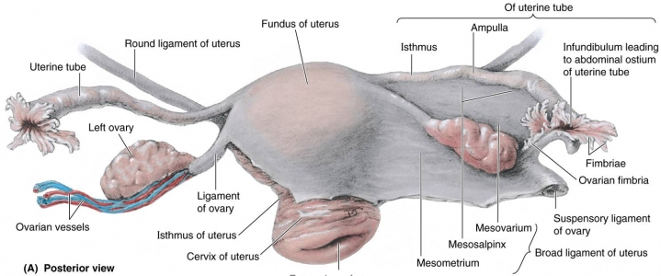
    Body: Lateral surfaces
      Attached to the broad ligament
      Round ligament of uterus and ovarian ligament attach here inferior to the opening of the uterine tube.

Slide 37
  Isthmus
    Constriction below body of uterus
    Demarcates body from cervix
    Indicates position of internal os
    internal os

Slide 38
  Cervix
    Narrow portion below isthmus projecting into vagina
    2 parts (Supravaginal-Vaginal)

Slide 39
  Cervix:
  Supravaginal part
  Separated from bladder anteriorly fascia (not covered by peritoneum )
  Posteriorly covered with peritoneum and related to the rectouterine pouch.

Slide 40
  Cervix: Vaginal part
  Projects into vagina
  The external os is the opening of cervix into vagina
  Surrounded by fornices (anterior, posterior, and lateral) of vagina; posterior fornix is the deepest one.
external os

Slide 41
Uterine walls consist of 3 layers
Outer serous layer (peritoneum or perimetrium)
Middle smooth muscle layer (myometrium), where main branches of blood vessels and nerves are located
Inner vascular and mucous layer (endometrium), which is partly sloughed off each month during menstruation

Slide 42
The cavity of the body of the uterus is shaped like an inverted triangle, when viewed anteriorly. Each of the superior corners of the cavity is continuous with the lumen of a uterine tube; the inferior corner is continuous with the central canal of the cervix.
    internal os
isthmus
external os

Slide 43
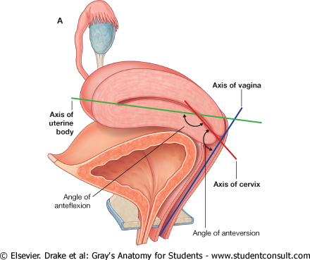
Normal position of the uterus (anteverted-anteflexed)

Slide 44
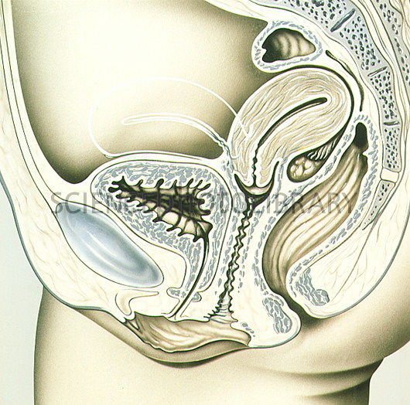
Retroflexed and retroverted

Slide 45
Peritoneal Relations: The peritoneum is reflected from the bladder (uterovesical pouch) to the isthmus and then over the fundus and onto the posterior aspect of the cervix (recto-uterine pouch) and upper part of the vagina.
Uterovesical pouch

Slide 46
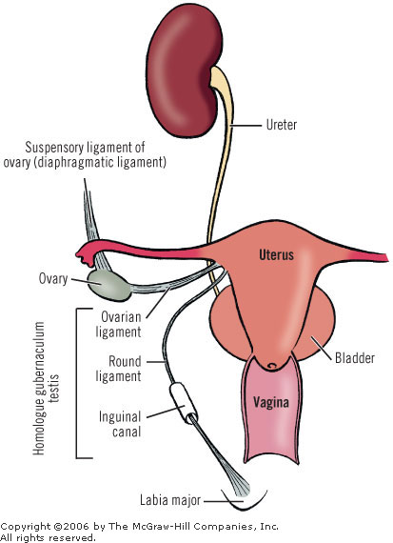
Ligaments: The paired round ligaments extend from the anterosuperior surface of the uterus through the inguinal canals to end in the labia majors.

Slide 47
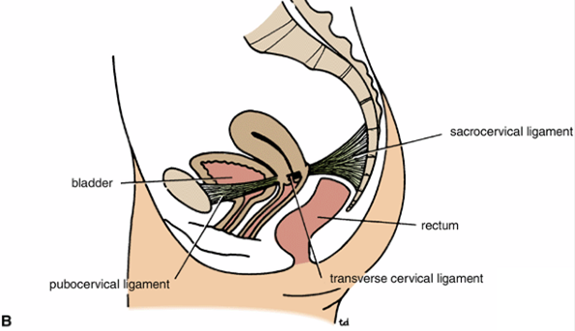
Ligaments: The uterosacral ligaments (sacrocervical) extend from the posterior wall of the uterus at the level of the internal cervical os to S2, 3, 4 segments of the sacrum.

Slide 48
Ligaments: The pubocervical ligament: from cervix to the pubic symphysis.

Slide 49
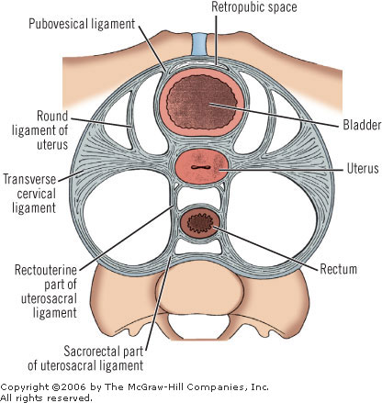
Ligaments: The cardinal ligament (or Mackenrodt's ligament, lateral cervical ligament, or transverse cervical ligament) is a major ligament of the uterus: from the side of the cervix into the fascia overlying the obturator muscles and the levator ani muscles.

Slide 50
Ligaments: The broad ligament of the uterus (plays a minimal role supports of the uterus) a wide fold of peritoneum that connects the sides of the uterus to the walls and floor of the pelvis

Slide 51
The broad ligament is divided into three components:
Mesometrium (largest portion ): is the mesentery of uterus.
Mesosalpinx: It is the mesentery of the fallopian tube. It lies between fallopian tube and the mesovarium.
Mesovarium: It is the mesentery of the ovaries.

Slide 52
Laterally, the peritoneum of the broad ligament is prolonged superiorly over the vessels as the suspensory ligament of the ovary.

Slide 53
Contents of broad ligament:
Fallopian tubes (in the anterosuperior free border)
Ovaries (contained in the mesovarium on the posterior aspect of the broad ligament)
Ovarian artery, vein and lymphatics (contained in the suspensory ligament of ovary)

Slide 54
Contents of broad ligament:
Uterine artery, vein and lymphatics
Round ligament of ovary (posterosuperiorly) and round ligament of uterus (anteroinferiorly)
Epoophoron and Paroophoron (embryonic remnant-lies in the broad ligament above the attachment of the mesovarium)

Slide 55
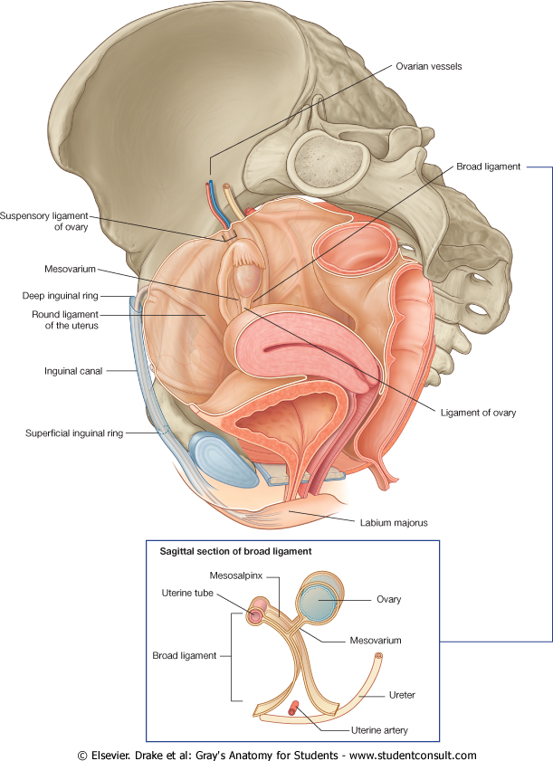
Functions of broad ligament: serves as the mesentery for the uterus, ovaries, and the fallopian tubes.
The principal support of the uterus is the pelvic floor.

Slide 56
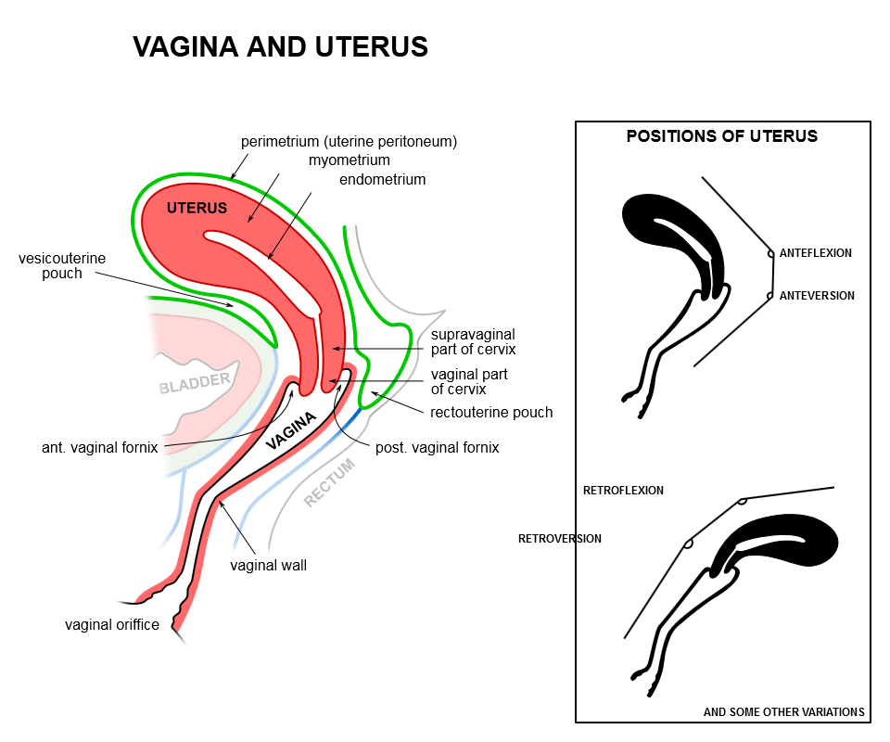
Vagina:
The cavity of the vagina communicates with that of the uterus, and it opens into the vestibule below.
The vagina extends inferiorly and anteriorly, parallel to the plane of the pelvic inlet

Slide 57
Vagina:
The anterior wall 7.5 cm and posterior walls 9 cm long.
The recess between the vagina and the vaginal part of the cervix consists of a continuous anterior, lateral, and posterior fornix. The posterior fornix, which is the deepest, is related to the recto-uterine pouch.

Slide 58
Vagina:
The opening of the vagina into the vestibule may be partially closed by a fold called the hymen.

Slide 59

Vaginal relation:
Anteriorly :fundus of the urinary bladder and urethra;
Posteriorly (from inferior to superior) to the anal canal, rectum, and rectouterine pouch.

Slide 60
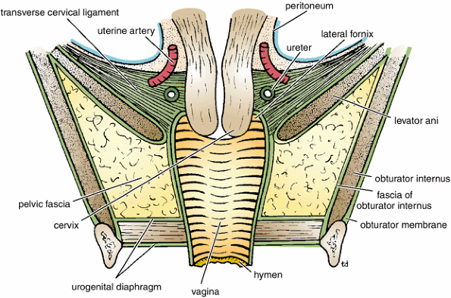
Vaginal relation:
laterally to the levator ani (The pubococcygeal muscles act as a sphincter for the vagina), visceral pelvic fascia, and ureters(The lateral fornix of the vagina is related to the ureter and uterine artery);

Slide 61
Uterine Tube
Duct to carry ova from ovary to uterus
Lies within mesosalpinx, the free upper border of broad ligament
Curves posterolaterally from side of uterus to ovary in ovarian fossa

Slide 62
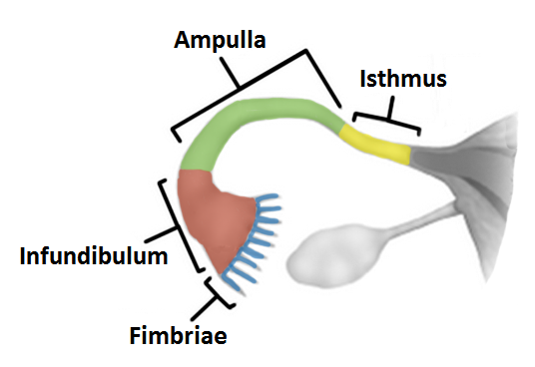
Uterine Tube Parts
Infundibulum: with abdominal ostium surrounded by fimbria which contacts ovary superiorly.
Ampulla (Wide middle part-Usual site of fertilization of ovum).
Isthmus: constricted medial part, which enters the uterus.
Intramural portion (interstitial or intrauterine part): passes through uterine wall to open into uterine cavity

Slide 63
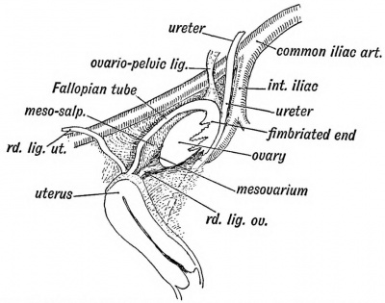
Location: In ovarian fossa on lateral wall of pelvis, with
external iliac vessels above,
ureter (forms ovarian fossa) postero-inferiorly,
covered by fimbria of uterine tube superiorly
Contained within a posterior projection of broad ligament called mesovarium
Ovary :Almond-shaped and -sized female gonads

Slide 64
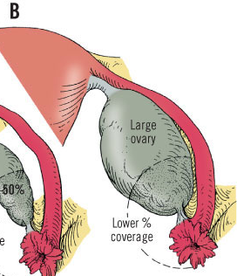
Surfaces and borders
  Lateral and medial surfaces
  Upper (tubal) extremity (border)
  Lower (uterine) extremity(border)
  Anterior (mesovarian) border
  Posterior (free) border

Slide 65
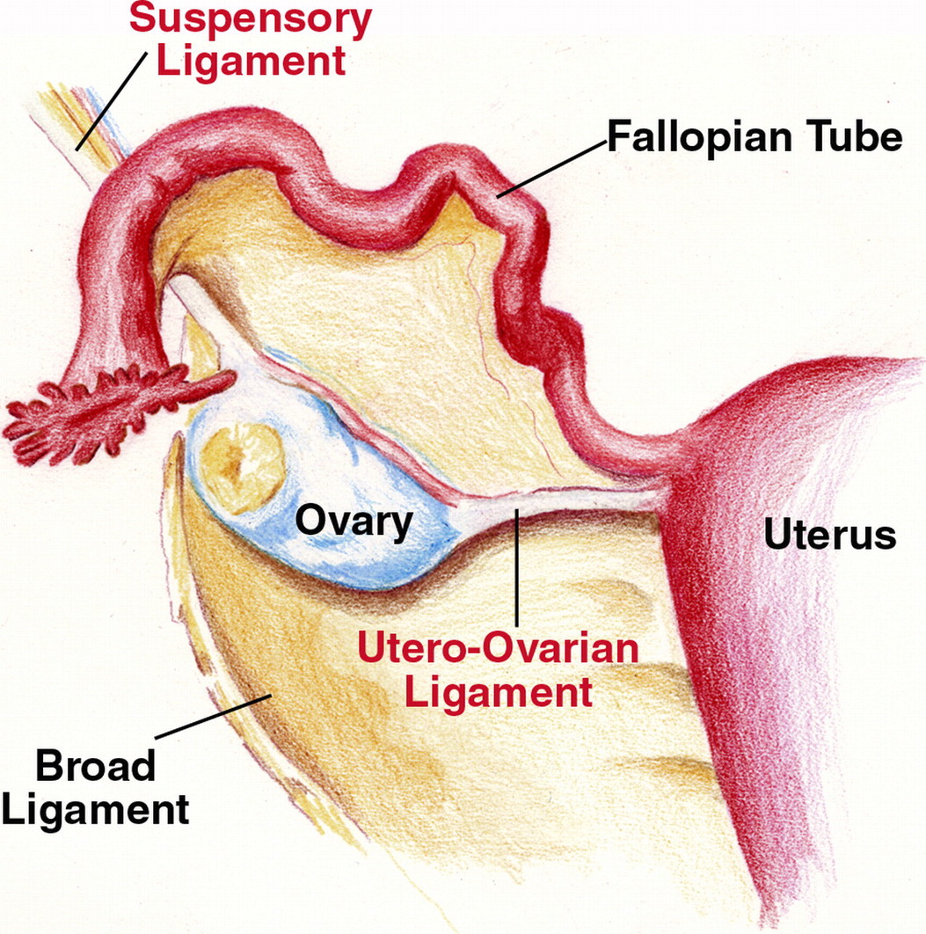
Supports
Suspensory ligament of ovary (Peritoneal fold running over external iliac vessels to reach upper extremity of ovary- Contains ovarian vessels and endopelvic fascia)
Mesovarium (Posterior projection from broad ligament-Continuous with mesosalpinx anterosuperiorly and mesometrium anteroinferiorly)
Ovarian ligament (Contained within mesovarium).

Slide 66
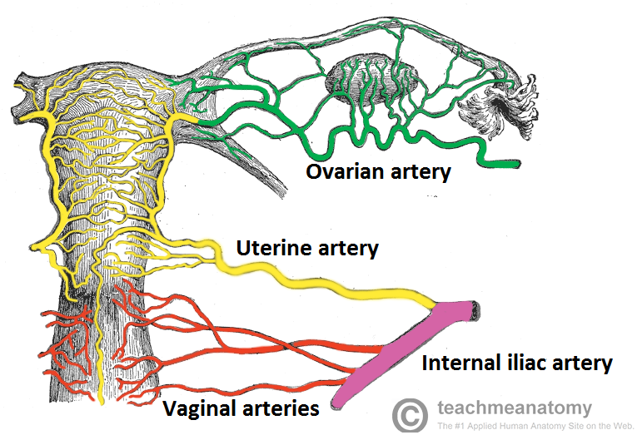
Blood Supply of the Female Internal Genital Organs
Uterus: Arterial supply: mainly from the uterine arteries(ascends between the layers of the broad ligament, near the lateral margin of the body, and supplies branches to both anterior and posterior surfaces+ branches from the ovarian arteries.

Slide 67
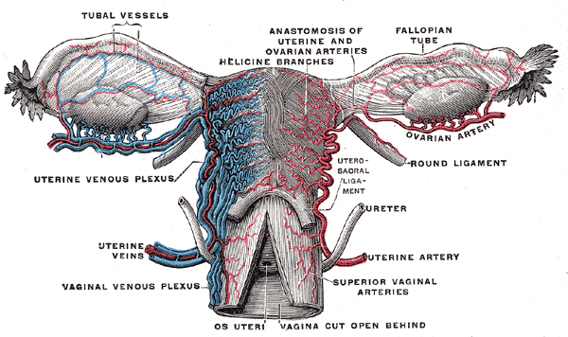
Blood Supply of the Female Internal Genital Organs
Uterus: The uterine veins: form a plexus on each side of the cervix. Veins from the uterine plexus drain into the internal iliac veins..

Slide 68
Blood Supply of the Female Internal Genital Organs
Vagina:
Arterial supply: The arteries supplying the superior part of the vagina derive from the uterine arteries. The arteries supplying the middle and inferior parts of the vagina derive from the vaginal and internal pudendal arteries

Slide 69
Blood Supply of the Female Internal Genital Organs
Vagina:
The vaginal veins form plexuses continuous with the uterine venous plexus and drain into the internal iliac veins

Slide 70
Blood Supply of the Female Internal Genital Organs
Ovaries :
Arterial supply: Ovarian artery
Ovarian veins –The right one drains into the inferior vena cava directly and the left one drains into the left renal vein.

Slide 71
Blood Supply of the Female Internal Genital Organs
Uterine Tube: Arterial supply: Uterine artery + Ovarian artery
Venous drainage: Ovarian veins.

Slide 72
Innervations of the Female Internal Genital Organs
Vagina and uterus : Sympathetic innervation originates in the inferior thoracic spinal cord segments (T10-L1)and passes through lumbar splanchnic nerves and the 2 hypogastric- uterovaginal series of plexuses.

Slide 73
Innervations of the Female Internal Genital Organs
Vagina and uterus : Parasympathetic innervation originates in the S2-S4 spinal cord segments and passes through the pelvic splanchnic nerves to the inferior hypogastric-uterovaginal plexus.

Slide 74
Innervations of the Female Internal Genital Organs
Ovaries and Uterine tubes.
The sympathetic and parasympathetic nerve supply derives partly from the ovarian plexus, descending with the ovarian vessels, and partly from the uterovaginal plexus originate from the superior and inferior hypogastric plexuses

Slide 75
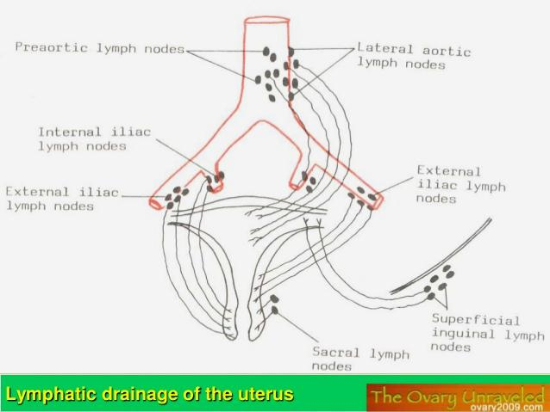
Lymphatic drainage from female pelvic viscera
Lymphatic vessels from the ovary follow the ovarian veins as they ascend to the lateral aortic lymph nodes.

Slide 76
Lymphatic vessels from the uterus : fundus and superior uterine body
with ovarian vessels to the lateral aortic lymph nodes;
some run along the round ligament of the uterus to the superficial inguinal lymph nodes.

Slide 77
Lymphatic vessels from the uterus : uterine body and some from the cervix
pass within the broad ligament to the external iliac lymph nodes

Slide 78
Lymphatic vessels from the uterus : from the uterine cervix
pass along the uterine vessels, within the transverse cervical ligaments, to the internal iliac lymph nodes,
and along uterosacral (sacrogenital) ligaments to the sacral lymph nodes

Slide 79
Lymphatic vessels from the vagina drain as follows:
Superior part: to the internal and external iliac lymph nodes.
Middle part: to the internal iliac lymph nodes.
Inferior part: to the sacral and common iliac nodes.
External orifice: to the superficial inguinal lymph nodes

